Slide 1
Term Project
CSCI 174 – Project Presentation
Mukhasir Shah Syed

Slide 2
Challenges
Telephone Words
Get the possible combination of words present on the key of a telephone.
Spiral Printing
Print the matrix value in clockwise fashion.

Slide 3
Telephone words
Given a 7 digit telephone number, print out all the possible sequences of letters that can represent the given telephone number.
In a standard 12 key pad, 0 and 1 do not have any letters associated with them. They are to be treated as such, i.e. a 0/1 in the telephone number will be retained in the final word as well.
Below mentioned mapping between numbers and characters is used:
0 => 0, 1 => 1, 2 => abc, 3 => def 4 => ghi
5 => jkl 6 => mno 7 => pqrs 8 => tuv 9 => wxyz
For an example input : 4155230
Output will be: g1jjad0,g1jjae0,g1jjaf0,g1jjbd0,g1jjbe0,g1jjbf0……..etc,

Slide 4
Spiral printing
Program to print a 2D array (n x m) in spiral order (clockwise)
Each line contains three items (semicolon delimited).
The first is 'n'(rows),
the second is 'm'(columns)
the third is a single space separated list of characters/numbers in row major order.
If we have a matrix then the challenge is to print the value in clockwise format. As in given example matrix will be for below format:
1 2 3
4 5 6
7 8 9
Output will be derived as 1 2 3 6 9 8 7 4 5.

Slide 5
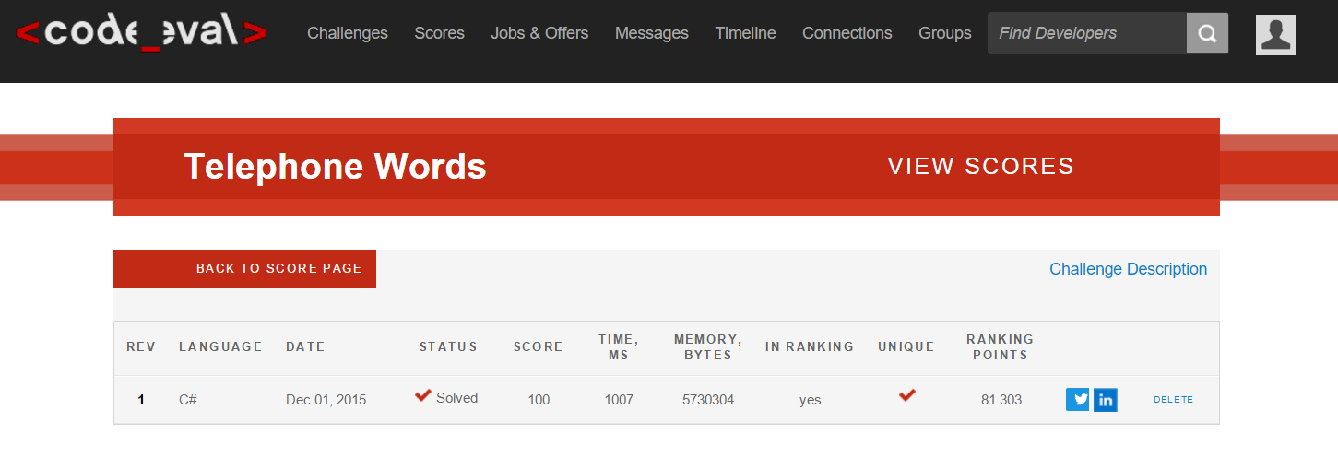
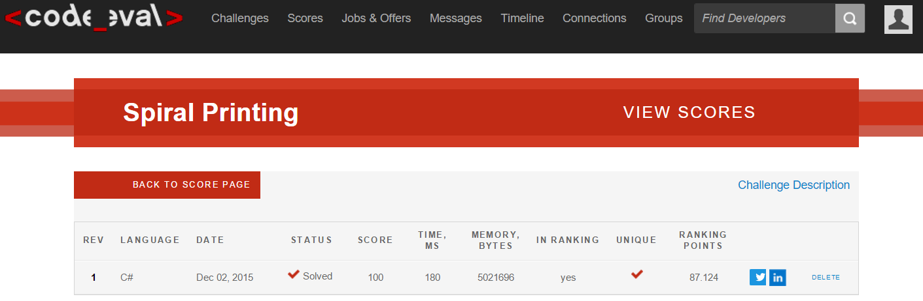
RESULTS on code eval

Slide 6
Thank you

